Slide 1

Artificial Intelligence
ARTIFICIAL NEURAL NETWORKS
(ANN)
Farhad Muhammad Riaz

Slide 2
Outline
Definition, why and how are neural networks being used in solving problems
Human biological neuron
Artificial Neuron
Applications of ANN
Comparison of ANN vs conventional AI methods

Slide 3



The idea of ANNs..?
NNs learn relationship between cause and effect or organize large volumes of data into orderly and informative patterns.
It’s a frog
frog
lion
bird
What is that?

Slide 4
Neural networks to the rescue…
Neural network: information processing paradigm inspired by biological nervous systems, such as our brain
Structure: large number of highly interconnected processing elements (neurons) working together
Like people, they learn from experience (by example)

Slide 5
Definition of ANN
“Data processing system consisting of a large number of simple, highly interconnected processing elements (artificial neurons) in an architecture inspired by the structure of the cerebral cortex of the brain”
(Tsoukalas & Uhrig, 1997).

Slide 6
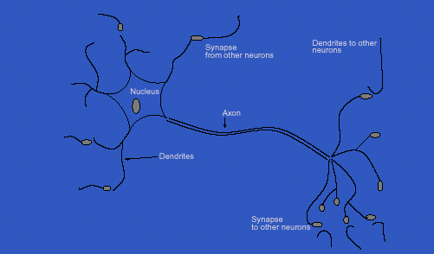
Inspiration from Neurobiology
Human Biological Neuron

Slide 7
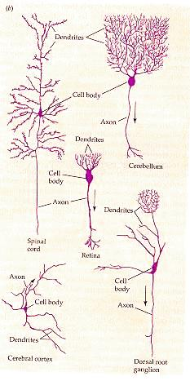
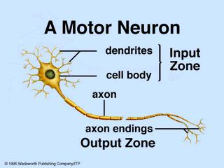
Biological Neural Networks
Biological neuron

Slide 8
Biological Neural Networks
A biological neuron has three types of main components; dendrites, soma (or cell body) and axon.
Dendrites receives signals from other neurons.
The soma, sums the incoming signals. When sufficient input is received, the cell fires; that is it transmit a signal over its axon to other cells.

Slide 9
Artificial Neurons
ANN is an information processing system that has certain performance characteristics in common with biological nets.
Several key features of the processing elements of ANN are suggested by the properties of biological neurons:
  The processing element receives many signals.
  Signals may be modified by a weight at the receiving synapse.
  The processing element sums the weighted inputs.
  Under appropriate circumstances (sufficient input), the neuron transmits a single output.
  The output from a particular neuron may go to many other neurons.

Slide 10
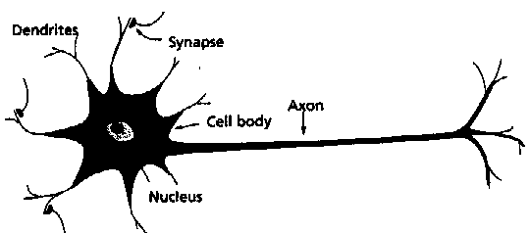
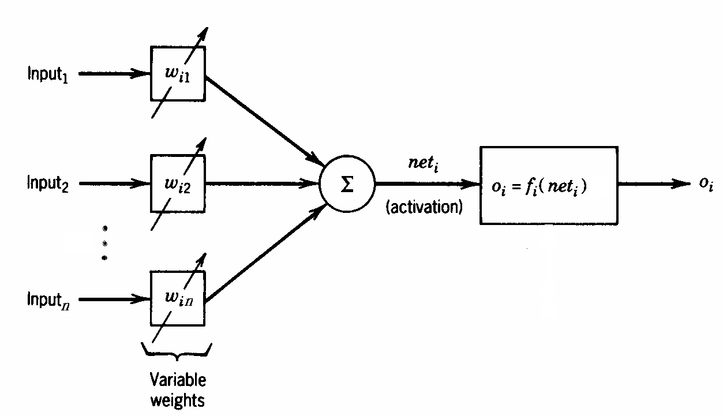
Artificial Neurons
A physical neuron
From experience: examples / training data
Strength of connection between the neurons is stored as a weight-value for the specific connection.
Learning the solution to a problem = changing the connection weights
An artificial neuron

Slide 11
Artificial Neurons
ANNs have been developed as generalizations of mathematical models of neural biology, based on the assumptions that:
  Information processing occurs at many simple elements called neurons.
  Signals are passed between neurons over connection links.
  Each connection link has an associated weight, which, in typical neural net, multiplies the signal transmitted.
  Each neuron applies an activation function to its net input to determine its output signal.

Slide 12
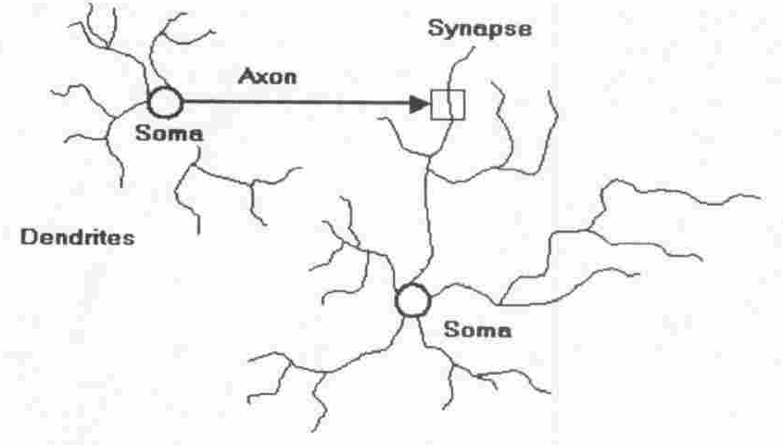
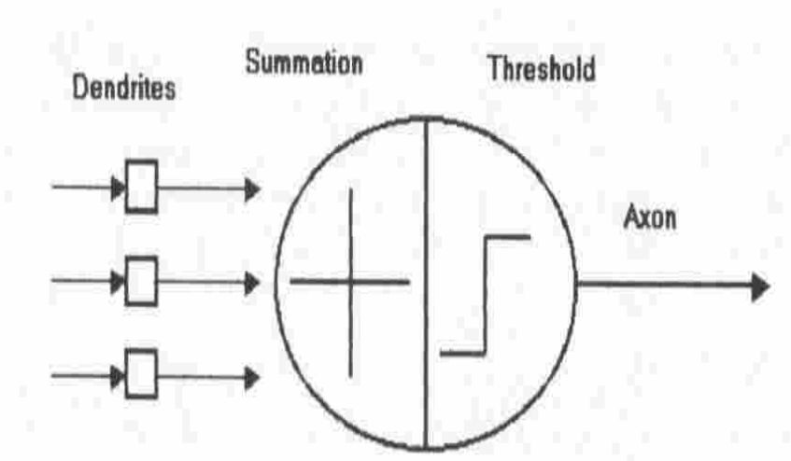
Artificial Neuron
Four basic components of a human biological neuron
The components of a basic artificial neuron

Slide 13
Model Of A Neuron
W_{a}
X₁
μ
W_{b}
f(μ)
Y
X₂
W_{c}
X₃
Input units
Connection weights
Summing function
computation
(dendrite)
(synapse)
(axon)
(soma)

Slide 14
A neural net consists of a large number of simple processing elements called neurons, units, cells or nodes.
Each neuron is connected to other neurons by means of directed communication links, each with associated weight.
The weight represent information being used by the net to solve a problem.

Slide 15
Each neuron has an internal state, called its activation or activity level, which is a function of the inputs it has received. Typically, a neuron sends its activation as a signal to several other neurons.
It is important to note that a neuron can send only one signal at a time, although that signal is broadcast to several other neurons.

Slide 16
Neural networks are configured for a specific application, such as pattern recognition or data classification, through a learning process
In a biological system, learning involves adjustments to the synaptic connections between neurons
➔ same for artificial neural networks (ANNs)

Slide 17
Artificial Neural Network
Synapse
Nukleus
x₁
w₁
∑
ƒ
y
Axon
x₂
w₂
Activation Function:
ƒ(y-in) = 1 if y-in >= θ
and ƒ(y-in) = 0
y_{in} = x₁w₁ + x₂w₂
Dendrite
    A neuron receives input, determines the strength or the weight of the input, calculates the total
    weighted input, and compares the total weighted with a value (threshold)
    The value is in the range of 0 and 1
    If the total weighted input greater than or equal the threshold value, the neuron will produce the
    output, and if the total weighted input less than the threshold value, no output will be produced

Slide 18
History
1943 McCulloch-Pitts neurons
1949 Hebb’s law
1958 Perceptron (Rosenblatt)
1960 Adaline, better learning rule (Widrow, Huff)
1969 Limitations (Minsky, Papert)
1972 Kohonen nets, associative memory

Slide 19
1977 Brain State in a Box (Anderson)
1982 Hopfield net, constraint satisfaction
1985 ART (Carpenter, Grossfield)
1986 Backpropagation (Rumelhart, Hinton, McClelland)
1988 Neocognitron, character recognition (Fukushima)

Slide 20
Characterization
Architecture
  a pattern of connections between neurons
    Single Layer Feedforward
    Multilayer Feedforward
    Recurrent
Strategy / Learning Algorithm
  a method of determining the connection weights
    Supervised
    Unsupervised
    Reinforcement
Activation Function
  Function to compute output signal from input signal

Slide 21
Single Layer Feedforward NN
x₁
w₁₁
w₁₂
y_{m}
w₂₁
x₂
y_{n}
w₂₂
output layer
Input layer
Contoh: ADALINE, AM, Hopfield, LVQ, Perceptron, SOFM

Slide 22
Multilayer Neural Network
z₁
x₁
V₁₁
∑
ƒ
w₁₁
w₁₂
V_{1n}
w₁₂
y₁
x₂
z₂
∑
ƒ
•
•
•
•
y₂
z_{n}
x_{m}
∑
ƒ
V_{mn}
Input layer
Output layer
Hidden layer
Contoh: CCN, GRNN, MADALINE, MLFF with BP, Neocognitron, RBF, RCE

Slide 23
Recurrent NN
Input
Outputs
Hidden nodes
Contoh: ART, BAM, BSB, Boltzman Machine, Cauchy Machine, Hopfield, RNN

Slide 24
Strategy / Learning Algorithm
Supervised Learning
Learning is performed by presenting pattern with target
During learning, produced output is compared with the desired output
  The difference between both output is used to modify learning weights according to the learning algorithm
Recognizing hand-written digits, pattern recognition and etc.
Neural Network models: perceptron, feed-forward, radial basis function, support vector machine.

Slide 25
Unsupervised Learning
Targets are not provided
Appropriate for clustering task
  Find similar groups of documents in the web, content addressable memory, clustering.
Neural Network models: Kohonen, self organizing maps, Hopfield networks.

Slide 26
Reinforcement Learning
Target is provided, but the desired output is absent.
The net is only provided with guidance to determine the produced output is correct or vise versa.
Weights are modified in the units that have errors

Slide 27
Activation Functions
Identity
f(x) = x
Binary step
f(x) = 1 if x >= θ
f(x) = 0 otherwise
Binary sigmoid
f(x) = 1 / (1 + e^{-σx})
Bipolar sigmoid
f(x) = -1 + 2 / (1 + e^{−σx})
Hyperbolic tangent
f(x) = (e^{x} – e^{-x}) / (e^{x} + e^{-x})

Slide 28
Exercise
2 input AND
2 input OR
1 | 1 | 1
1 | 0 | 0
0 | 1 | 0
0 | 0 | 0
1 | 1 | 1
1 | 0 | 1
0 | 1 | 1
0 | 0 | 0

Slide 29
x₁
w₁= 0.5
∑
ƒ
y
x₂
w₂ = 0.3
Activation Function:
Binary Step Function
θ = 0.5,
ƒ(y-in) = 1 if y-in >= θ
dan ƒ(y-in) = 0
y_{in} = x₁w₁ + x₂w₂

Slide 30
Where can neural network systems help…
when we can't formulate an algorithmic solution.
when we can get lots of examples of the behavior we require.
‘learning from experience’
when we need to pick out the structure from existing data.

Slide 31
Who is interested?...
Electrical Engineers – signal processing, control theory
Computer Engineers – robotics
Computer Scientists – artificial intelligence, pattern recognition
Mathematicians – modelling tool when explicit relationships are unknown

Slide 32
Problem Domains
Storing and recalling patterns
Classifying patterns
Mapping inputs onto outputs
Grouping similar patterns
Finding solutions to constrained optimization problems

Slide 33
Classification
Coronary
Disease
ST
OP
01
10
Neural
1
1
Net
1
1
10
00
00
1
1
Input patterns
00
Input layer
Output layer
00
01
10
1
1
00
Sorted
10
1
1
patterns
.
00
1
1

Slide 34
Clustering
00
1
1
10
1
1
10
00
1
1
00
01

Slide 35

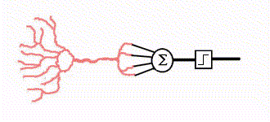
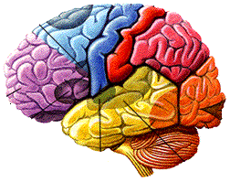

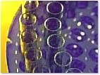


ANN Applications
Medical Applications
Information
Searching & retrieval
Chemistry
Education
Business & Management

Slide 36
Applications of ANNs
Signal processing
Pattern recognition, e.g. handwritten characters or face identification.
Diagnosis or mapping symptoms to a medical case.
Speech recognition
Human Emotion Detection
Educational Loan Forecasting

Slide 37
Abdominal Pain Prediction
Intensity
Duration
Male
Age
Temp
WBC
Pain
Pain
adjustable
1
20
37
10
1
1
20
37
10
1
1
1
weights
Appendicitis
Diverticulitis
Ulcer
Pain
Cholecystitis
Obstruction
Pancreatitis
Duodenal
Non-specific
Small Bowel
Perforated
0
0
0
1
0
0
0

Slide 38
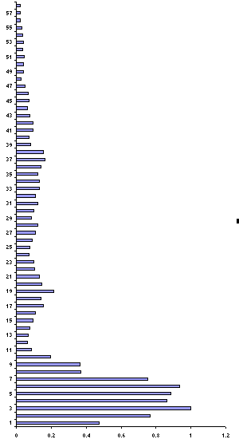
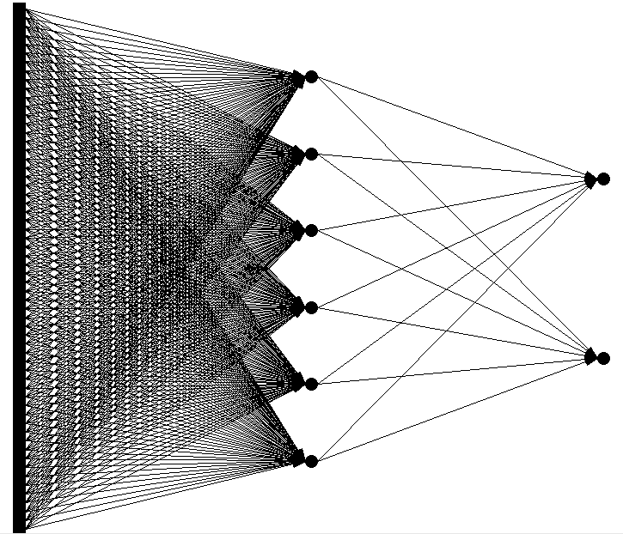
Voice Recognition

Slide 39
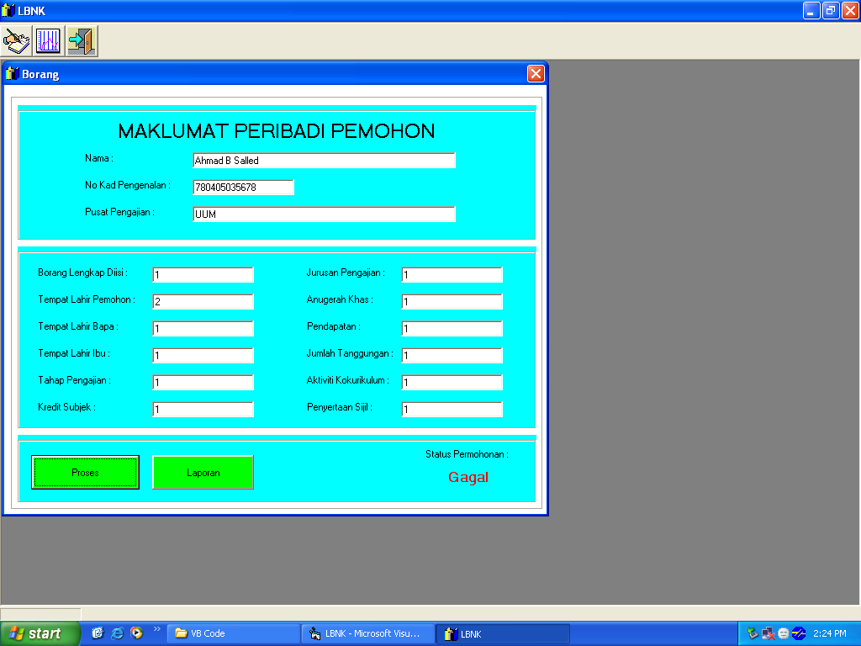
Educational Loan Forecasting System

Slide 40
Advantages Of NN
NON-LINEARITY
It can model non-linear systems
INPUT-OUTPUT MAPPING
It can derive a relationship between a set of input & output responses
ADAPTIVITY
The ability to learn allows the network to adapt to changes in the surrounding environment
EVIDENTIAL RESPONSE
It can provide a confidence level to a given solution

Slide 41
Advantages Of NN
CONTEXTUAL INFORMATION
Knowledge is presented by the structure of the network. Every neuron in the network is potentially affected by the global activity of all other neurons in the network. Consequently, contextual information is dealt with naturally in the network.
FAULT TOLERANCE
Distributed nature of the NN gives it fault tolerant capabilities
NEUROBIOLOGY ANALOGY
Models the architecture of the brain

Slide 42
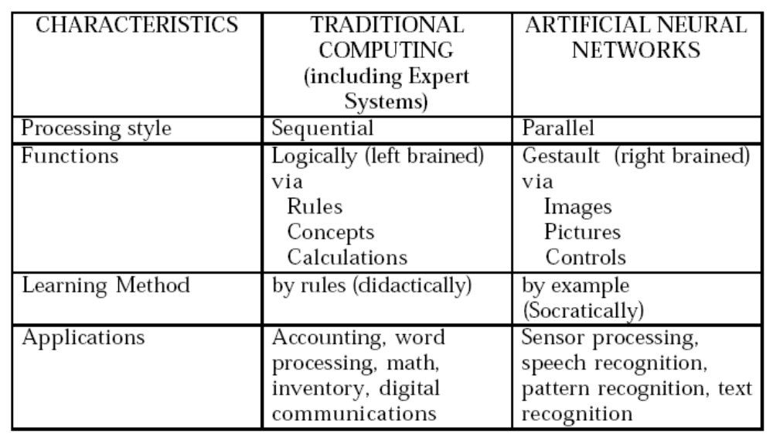
Comparison of ANN with conventional AI methods

